Slide 1
EFIS
Electronic Flight Instrument System
An electronic flight instrument system (EFIS) is a flight deck instrument display system that displays flight data electronically rather than electromechanically. An EFIS normally consists of a primary flight display (PFD), multi-function display (MFD), and an engine indicating and crew alerting system (EICAS) display. Early EFIS models used cathode ray tube (CRT) displays, but liquid crystal displays (LCD) are now more common. The complex electromechanical attitude director indicator (ADI) and horizontal situation indicator (HSI) were the first candidates for replacement by EFIS. Now, however, few flight deck instruments cannot be replaced by an electronic display.

Slide 2
PFD
Primary Flight Display
A primary flight display or PFD is a modern aircraft instrument dedicated to flight information. Much like multi-function displays, primary flight displays are built around an Liquid-crystal display or CRT display device.
Representations of older six pack or "steam gauge" instruments are combined on one compact display, simplifying pilot workflow and streamlining cockpit layouts.

Slide 3
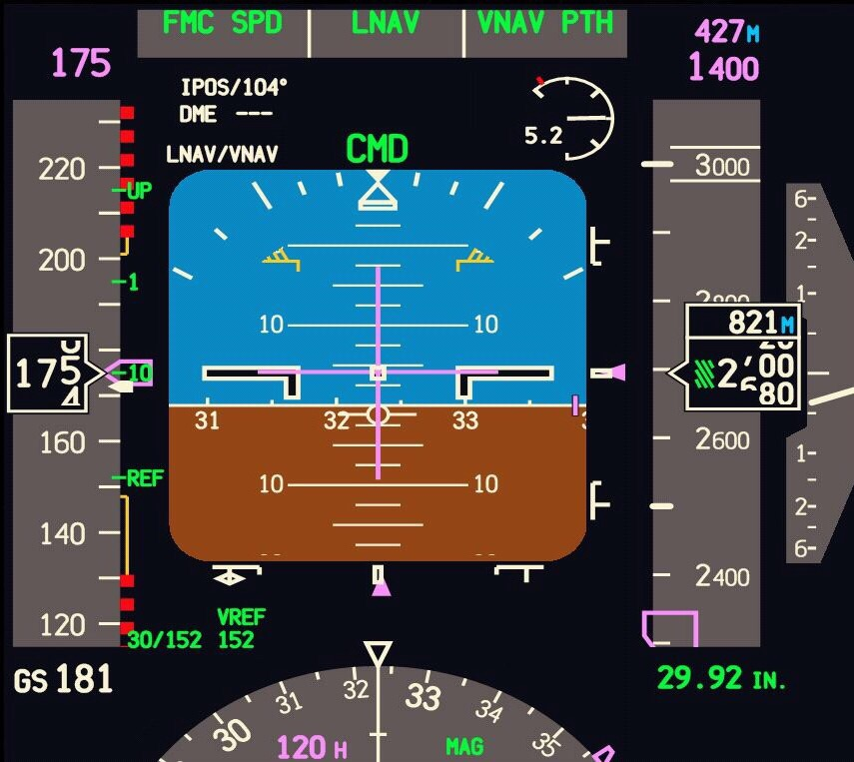

Slide 4
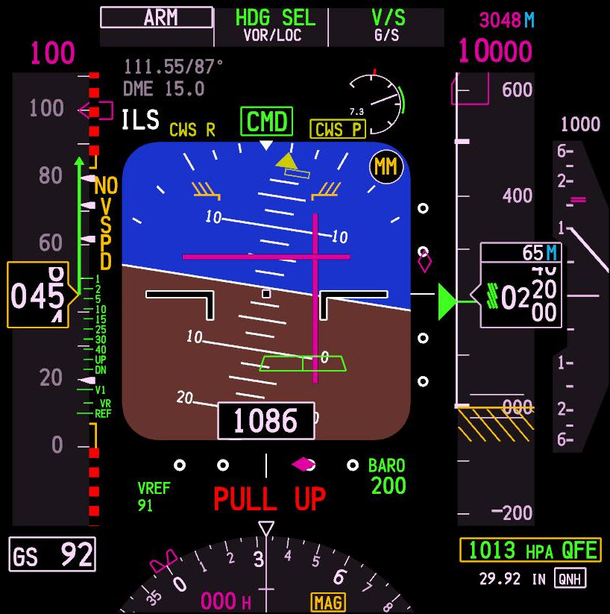

Slide 5
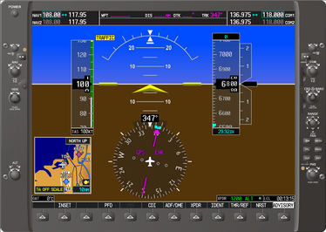
G1000

Slide 6
B737

