Slide 1
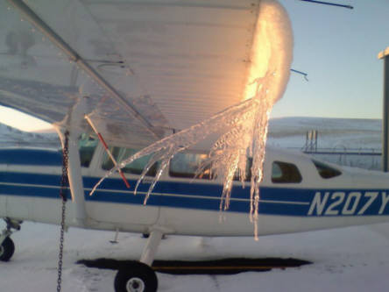
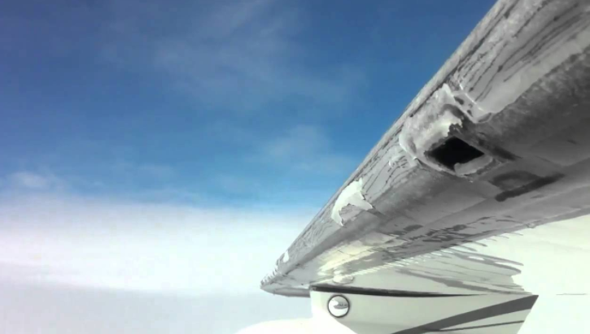
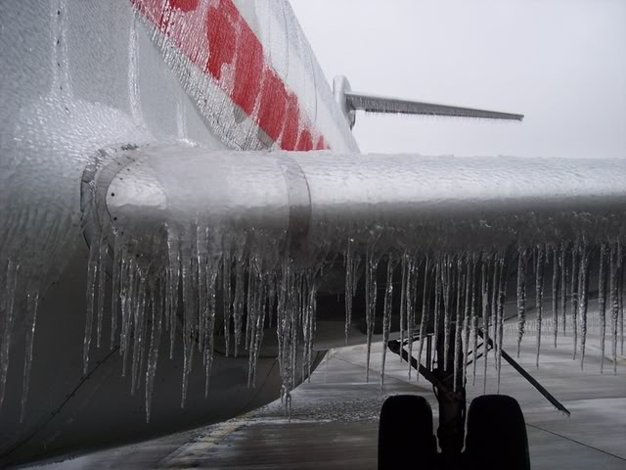
ANTI-ICE SYSTEM

Slide 2
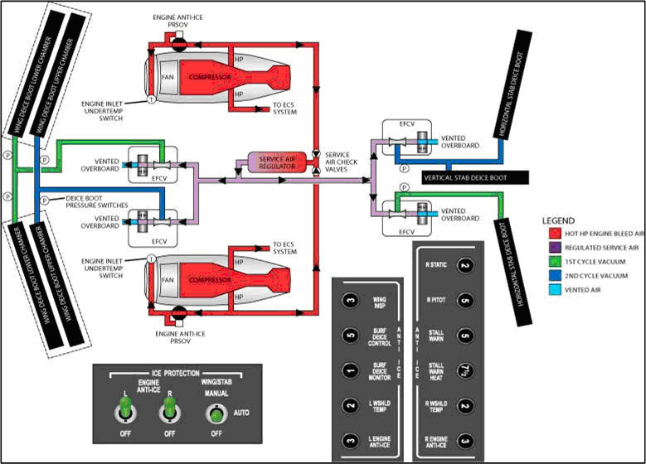

Slide 3
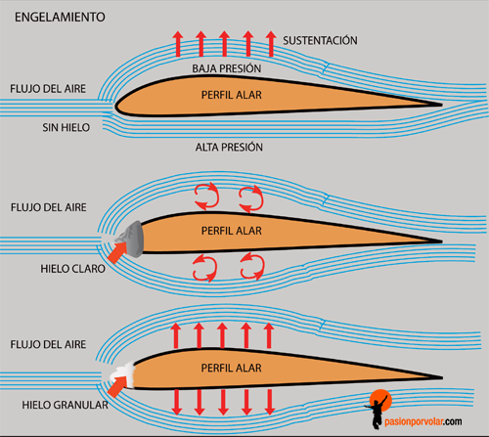

Slide 4
El hielo
WING & ENGINE Anti-Ice systems! Explained by CAPTAIN JOE
Ultra Ice Protection System
Boots Deicing in Severe Icing Conditions ATR
Icing Boots in Action C210
Segundos Catastróficos - Accidente Aéreo en Potomac
Frozen in Flight Part1
Frozen in Flight Part2
Frozen in Flight Part3

